Slide 1
Stroke Prediction
Mini project 2
By Darryl rusli

Slide 2
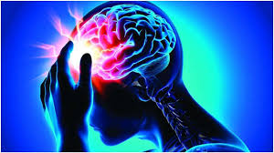
Context
Stroke is the 2nd leading cause of death globally according to World Health Organization (WHO)
Responsible for approximately 11% of total of deaths
Stroke occurs when there is no or not enough blood supply that that carries oxygen and nutrient to the brain
Stroke attacks the brain and the human control centre and can cause disability

Slide 3
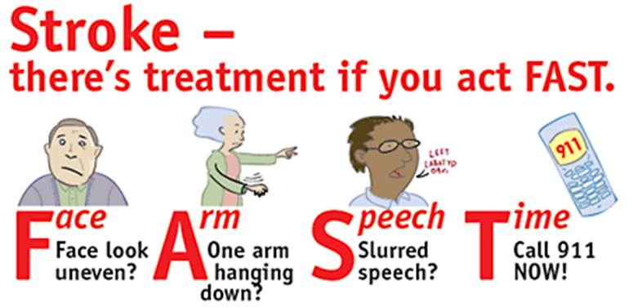
Context (Continued)
What are the symptoms?
Trouble speaking
numbness occur on any part of the body
Trouble seeing in either one or both eyes
Slurred Speech
Dizziness
Trouble Walking
Severe Headache

Slide 4
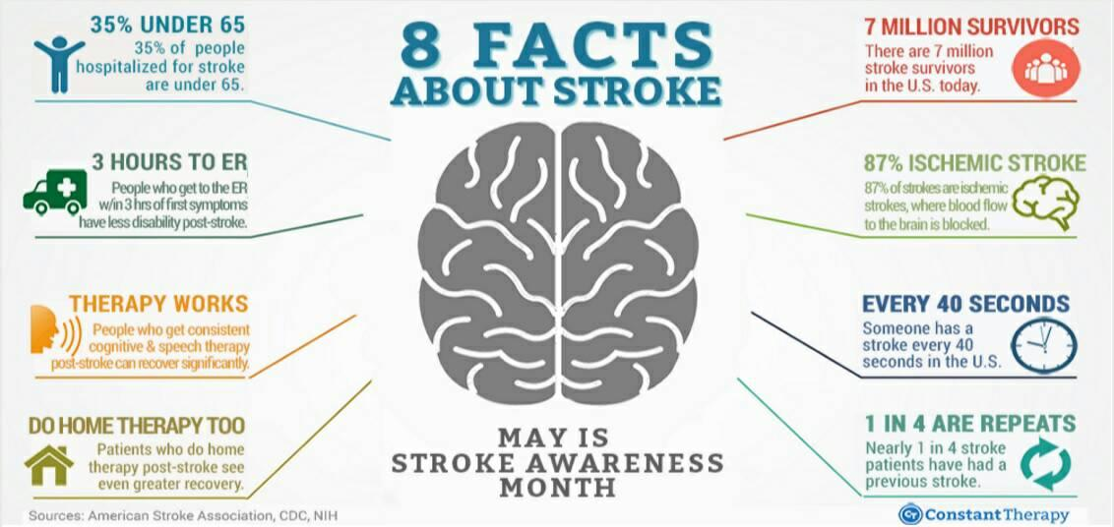
Business Question
Is stroke likely to happen on patient based on gender, age, any association disease like hypertension or heart disease, work type and smoking status?
Reason of asking question: age, gender, smoking status, and hypertension are the major risk factor.
How do you prevent stroke?
What is the best predictive model to predict stroke?

Slide 5
Data Pipeline
Define
Exploratory Data Analysis
Prepare
Pre-processing
Modelling
Model Interpretation

Slide 6
Datasets
Dataset: Stroke Prediction
Observations = 5110
Features: 12
3 Numerical Features
9 Categorical Features
id | gender | age | hypertension | heart_disease | ever_married | work_type | Residence_type | avg_glucose_level | bmi | smoking_status | stroke
9046 | Male | 67.0 | 0 | 1 | Yes | Private | Urban | 228.69 | 36.600000 | formerly smoked | 1
51676 | Female | 61.0 | 0 | 0 | Yes | Self-employed | Rural | 202.21 | 28.893237 | never smoked | 1
31112 | Male | 80.0 | 0 | 1 | Yes | Private | Rural | 105.92 | 32.500000 | never smoked | 1
60182 | Female | 49.0 | 0 | 0 | Yes | Private | Urban | 171.23 | 34.400000 | smokes | 1
1665 | Female | 79.0 | 1 | 0 | Yes | Self-employed | Rural | 174.12 | 24.000000 | never smoked | 1

Slide 7
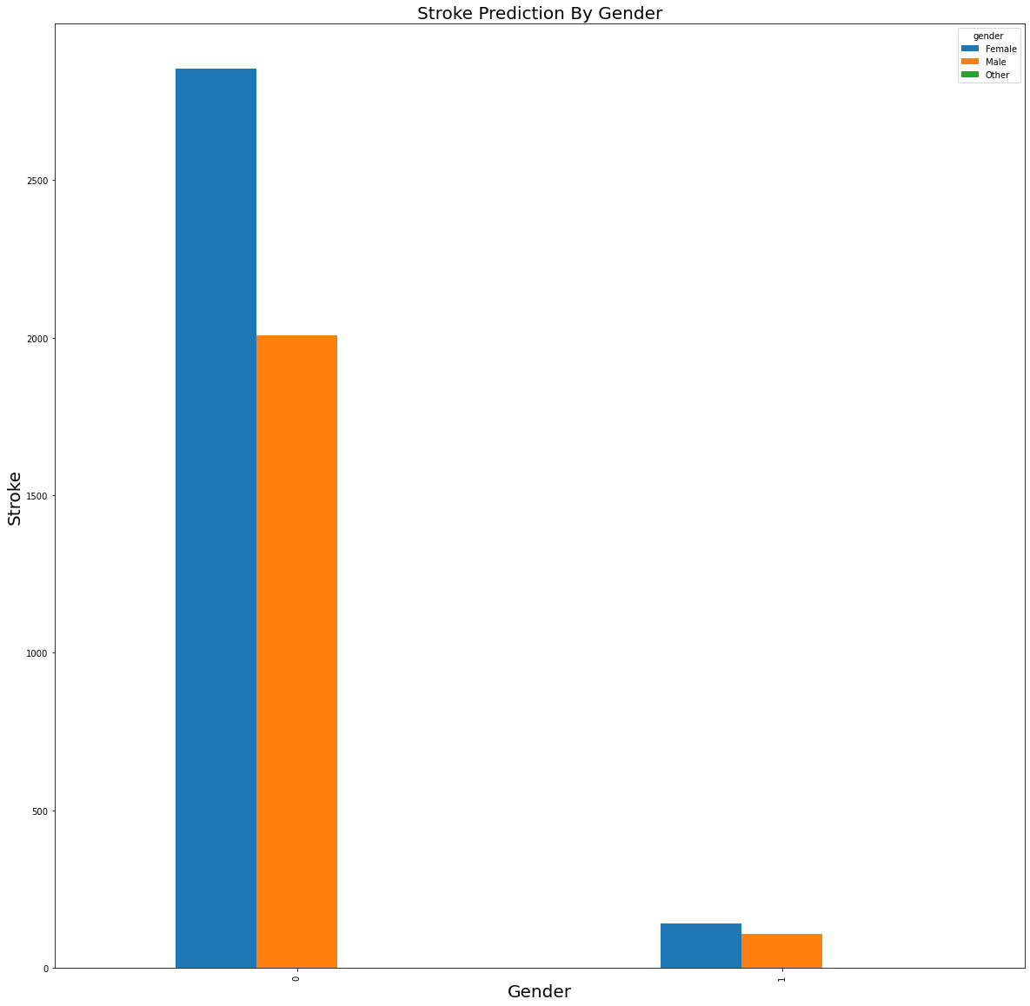
Exploratory Data Analysis
Stroke Prediction By Gender
According to this plot, female is more likely to get stroke because female has more events.
Female are less likely to recover from stroke

Slide 8
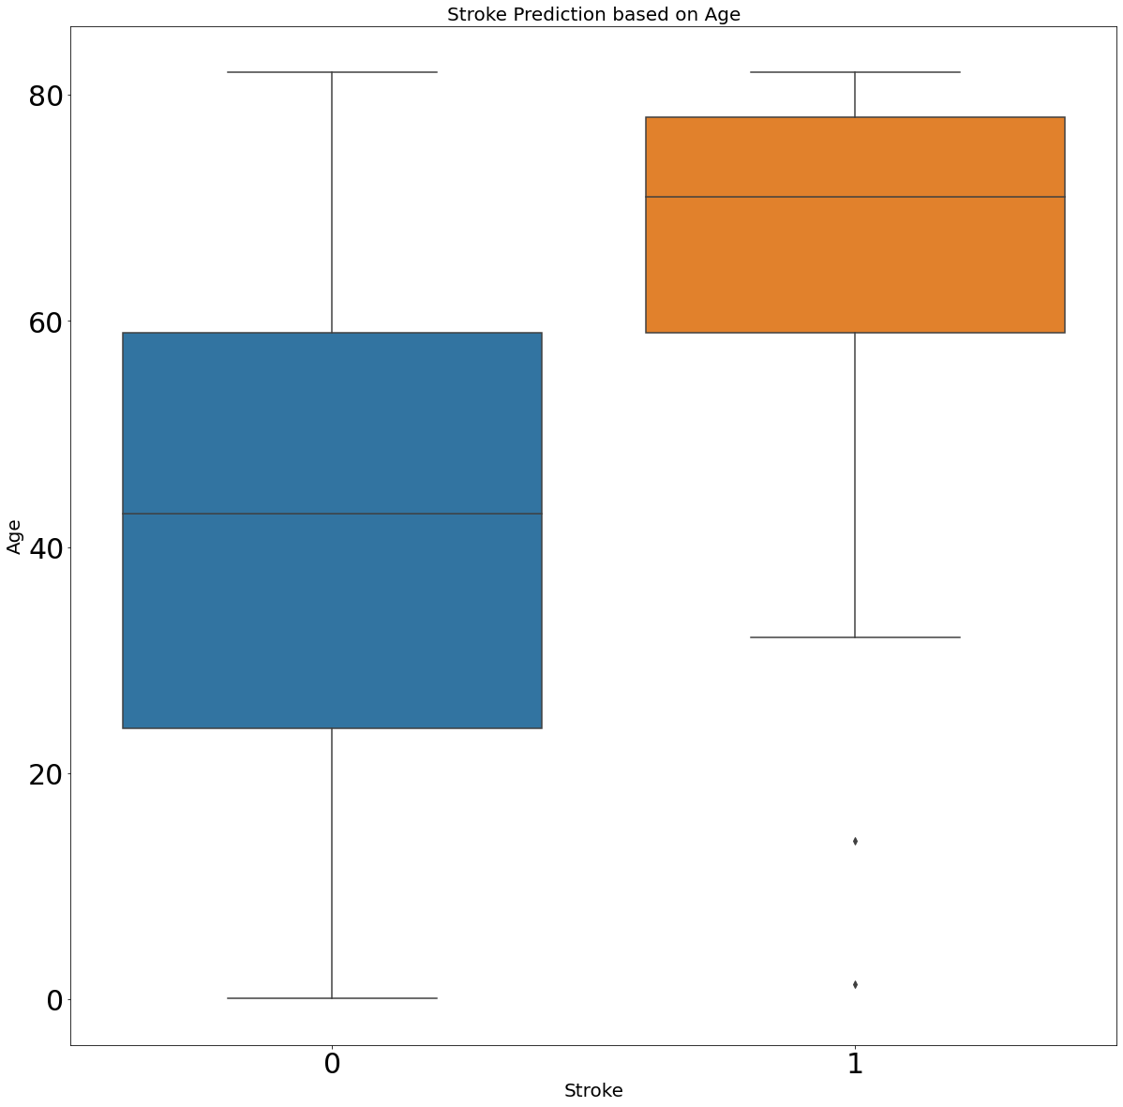
Exploratory Data Analysis
Stroke Prediction based on Age
Majority of the patients who are between the age 60 or older have stroke according to the graph that is shown

Slide 9
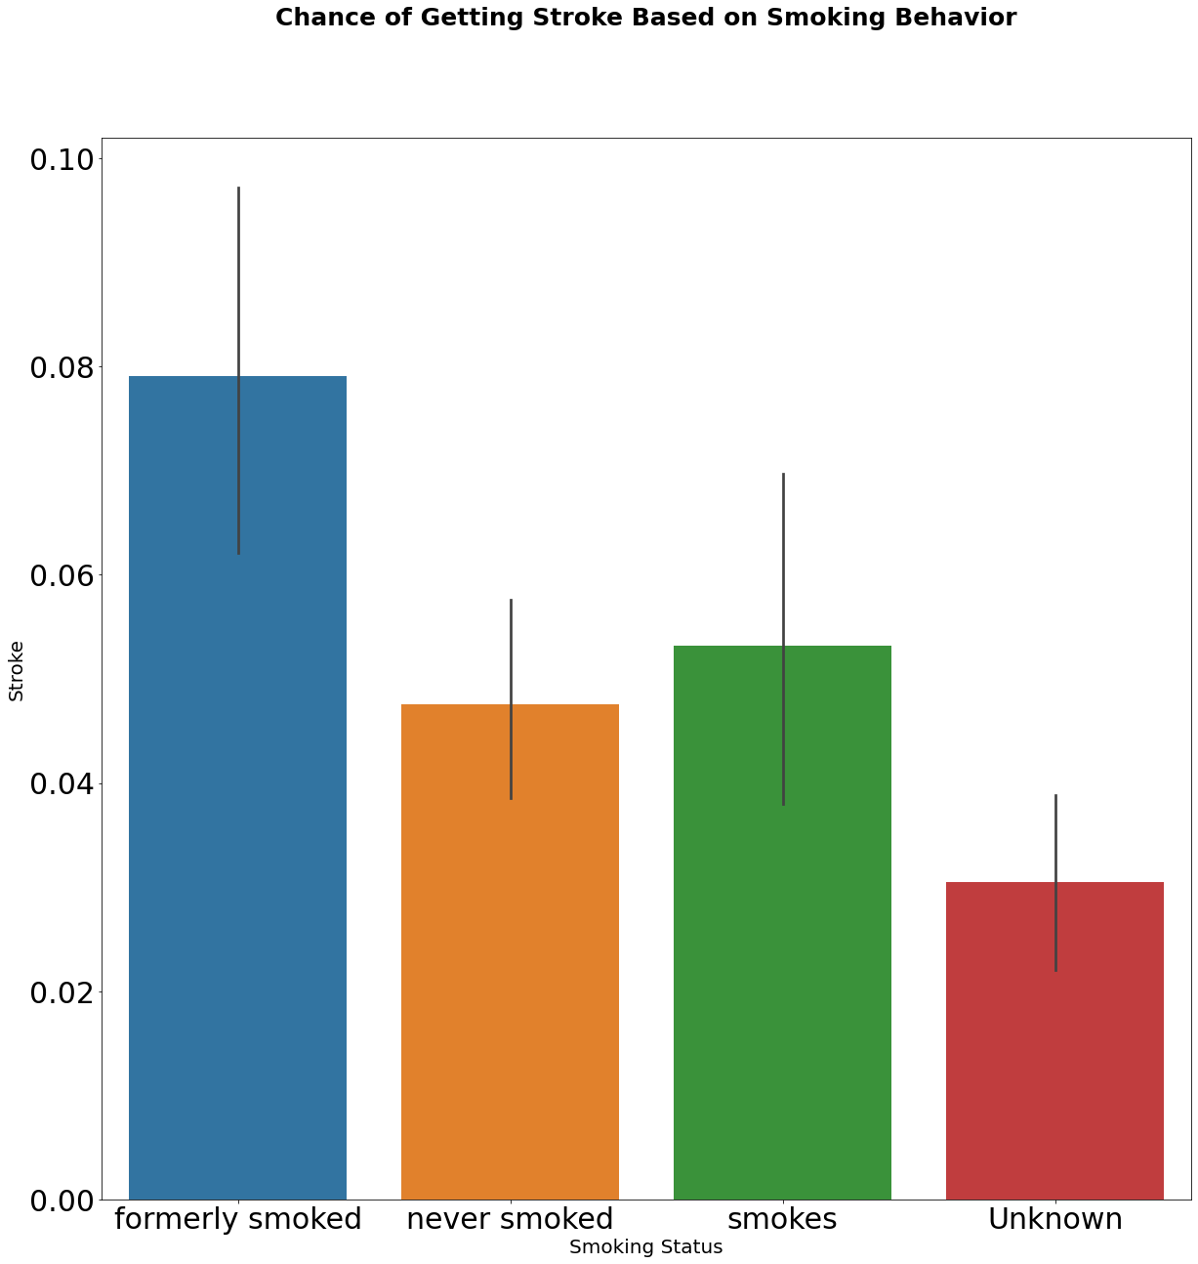
Exploratory Data Analysis
Stroke prediction based on smoking status
Stroke will also likely to occur to the majority of people that ever smoked or still smoking based on the insight that we can get from the plot.

Slide 10
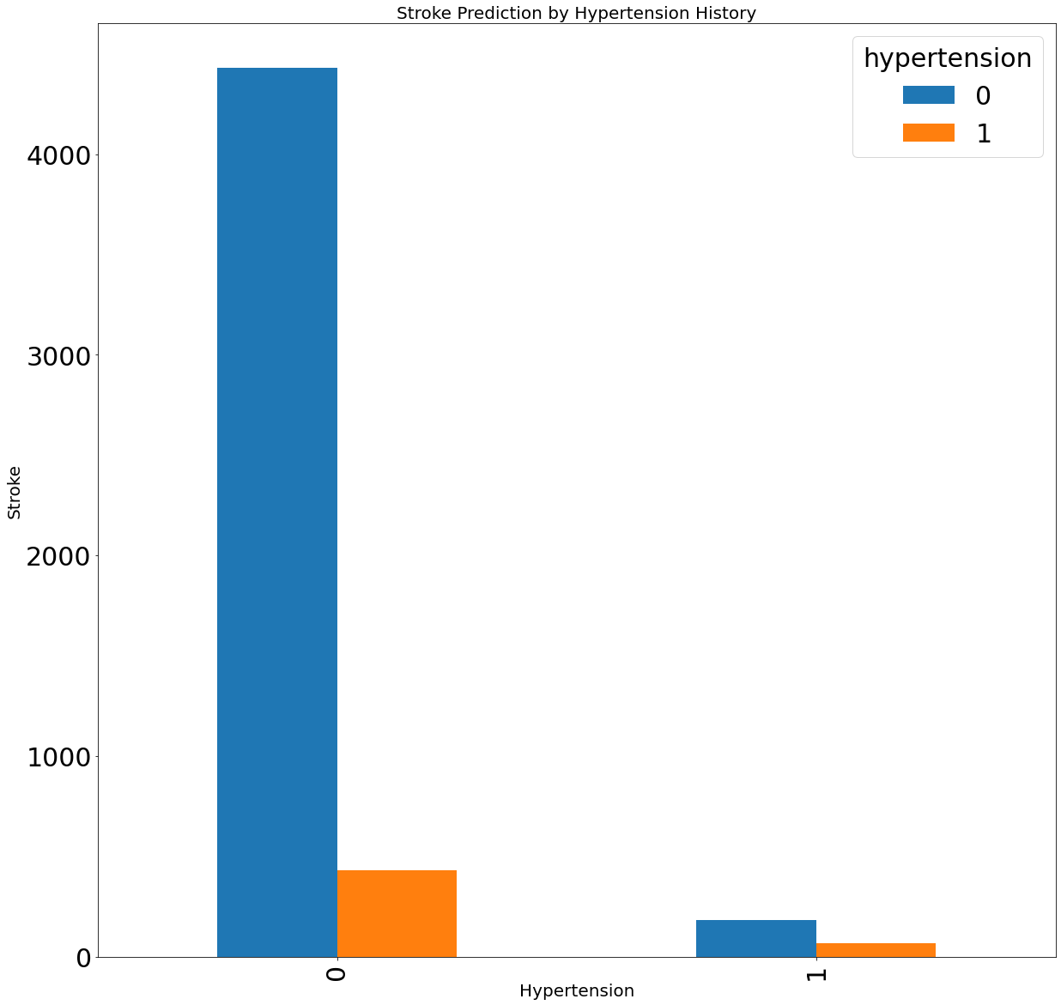
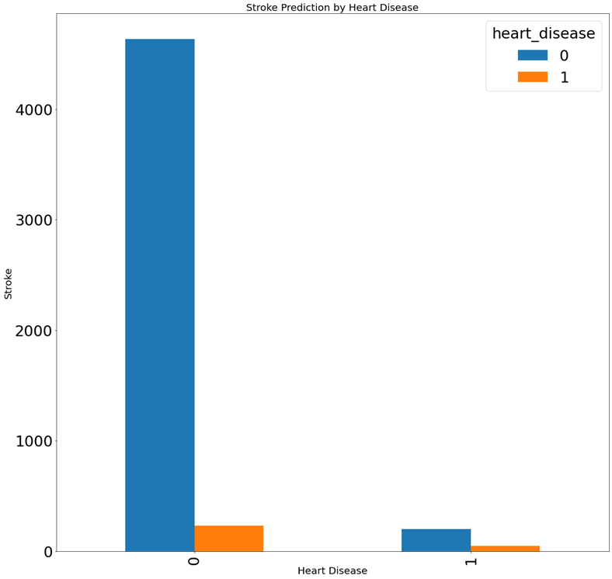
Exploratory Data Analysis
Based on the insights that we can get from the 2 plots, majority patients with the health history such as heart disease or hypertension doesn’t have stroke.

Slide 11
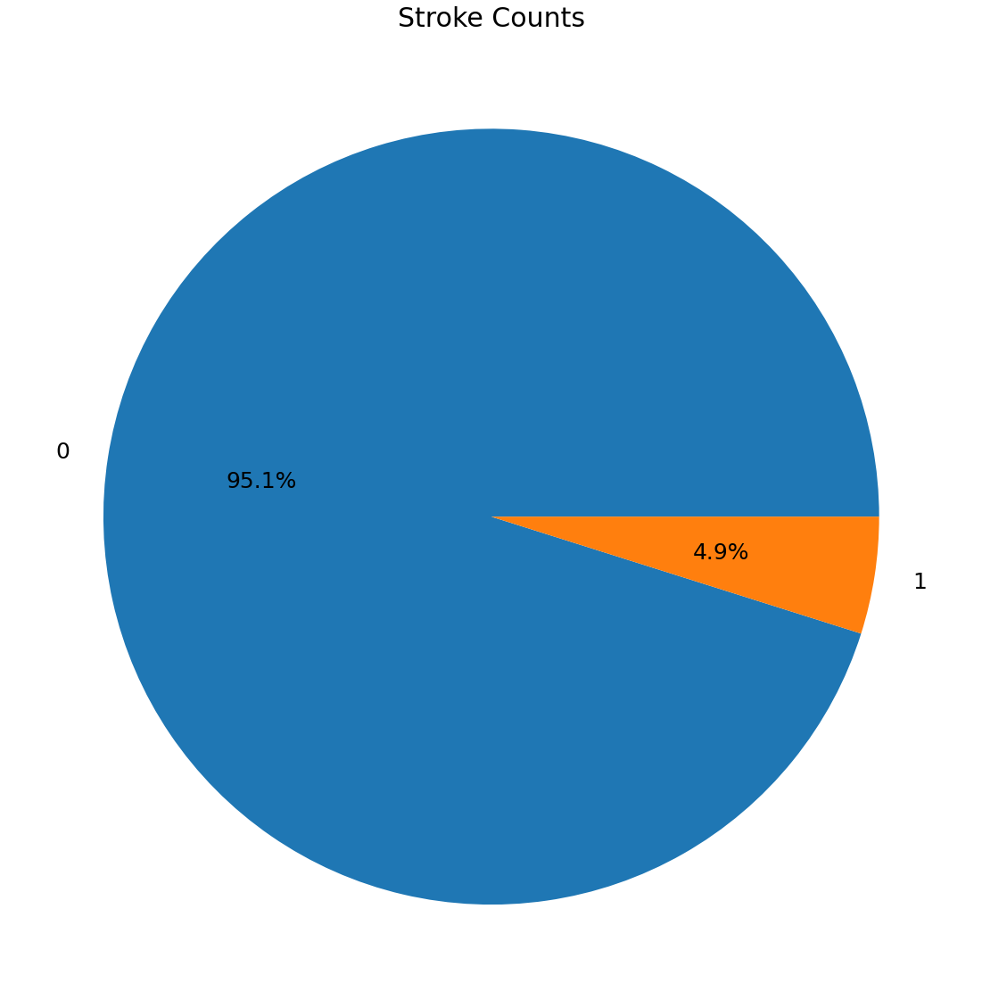
Imbalanced Data Target

Slide 12
Tested Predictive Models
Logistic Regression
Support Vector Machine
Naive Bayes
K Nearest Neighbour
Random Forest Classifier

Slide 13
Pre-Process: Random Under Sampling
 | Data Value
Before Oversampling | 0 = 3899 1 = 199
After Oversampling | 0 = 199 1 = 199

Slide 14
Next:
Confusion matrix of each model before and after under sampling

Slide 15
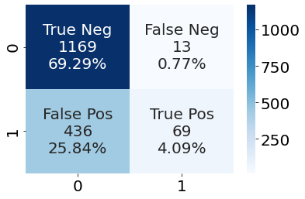
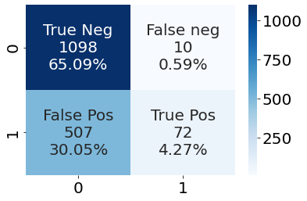
Logistic Regression Confusion Matrix
After under sampling
Before under sampling
Rows: Actual
Columns: Predicted
0: Healthy
1: Stroke

Slide 16
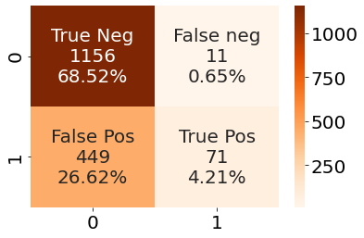
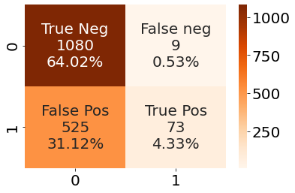
Support Vector Machine Confusion Matrix
Before Under Sampling
After Under Sampling
Rows: Actual
Columns: Predicted
0: Healthy
1: Stroke

Slide 17
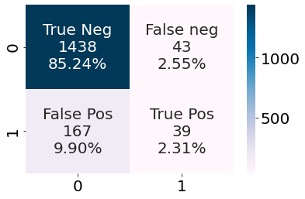
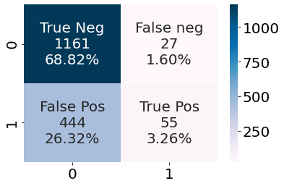
Gaussian Naïve Bayes Confusion Matrix
Before Under Sampling
After Under Sampling
Rows: Actual
Columns: Predicted
0: Healthy
1: Stroke

Slide 18
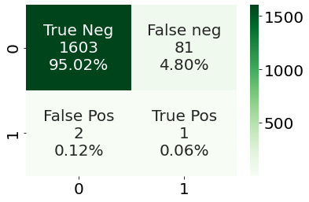
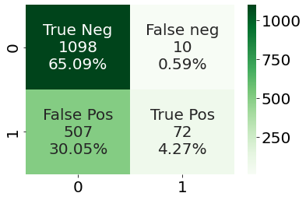
KNN Confusion Matrix
Before Under Sample
After Under Sample
Rows: Actual
Columns: Predicted
0: Healthy
1: Stroke

Slide 19
Random Forest Confusion Matrix
Before Under Sampling
After Under Sampling
Rows: Actual
Columns: Predicted
0: Healthy
1: Stroke

Slide 20
Next:
Modelling report

Slide 21
Model Classification Report
 | Precision | Recall | Accuracy | AUC | F1-Score
Logistic Regression | 0.13 | 0.88 | 0.69 | 0.84567 | 0.21785
Support Vector Machine | 0.12 | 0.89 | 0.68 | 0.83928 | 0.21471
Gaussian Naïve Bayes | 0.11 | 0.67 | 0.72 | 0.714525 | 0.21471
KNN | 0.0 | 0.0 | 0.95 | 0.50 | 0.0
Random Forest | 0.12 | 0.88 | 0.69 | 0.82480 | 0.21242
Classification Report Table Summary:
Support Vector Machine has the highest recall score based on the Modelling Classification Report where Logistic Regression has the highest Area Under the Curve which is recommended

Slide 22
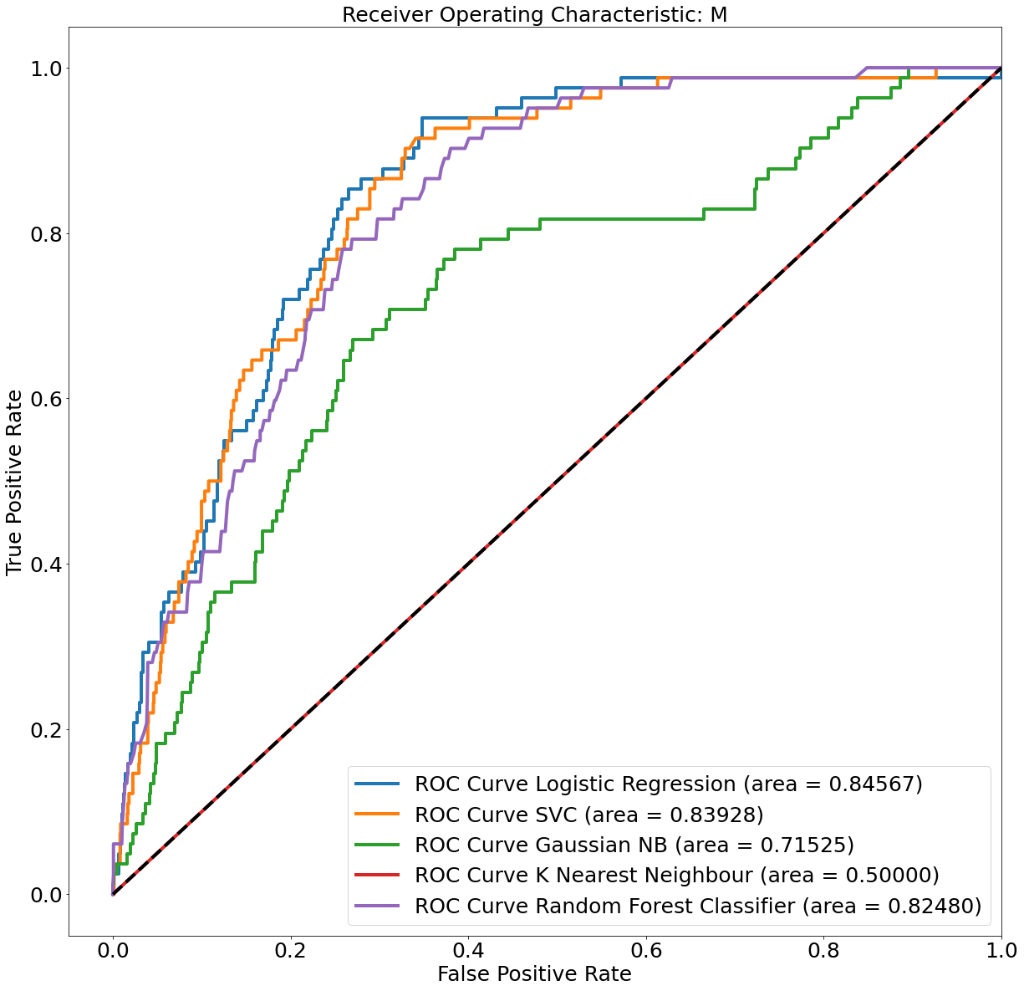
Modelling: ROC Curve
Modelling:
As we can we from the Receiver Operating Characteristic performance, the best overall predictor model would be Logistic Regression despite the fact that Support Vector Machine has the highest recall but ranks the second when it comes to Receiver Operating Characteristic Score

Slide 23
Summary
Female patients are more likely to have stroke as female has more events
Majority of patients who have stroke are between the age of 60 to 80 years old
Patients who are formerly smoker and current smoker are having stroke
Majority patients with the health history such as heart disease or hypertension doesn’t have stroke.
To prevent stroke, patient has to do the following
Check cholesterol
Control medical condition
Control Diabetes
Don’t smoke
Treat Heart Disease
Logistic Regression is the best model prediction according to the ROC despite the fact that Support Vector Machine has the highest recall score

Slide 24
Limitation & Next Steps
Limitations
The target is imbalanced with:
95.1% negative
4.9% positive
Next Steps
Pick Feature Selection to reduce complexity
Using Neural Network to predict stroke more accurately where we are applying weights

Slide 25
Thank you
Questions?

